Slide 1
Chatbot Conversations: A Comparative Study on User Interaction and Preference
Louis Bodfield
Dual-Bot Insights (dual-bot-insights.vercel.app)

Slide 2
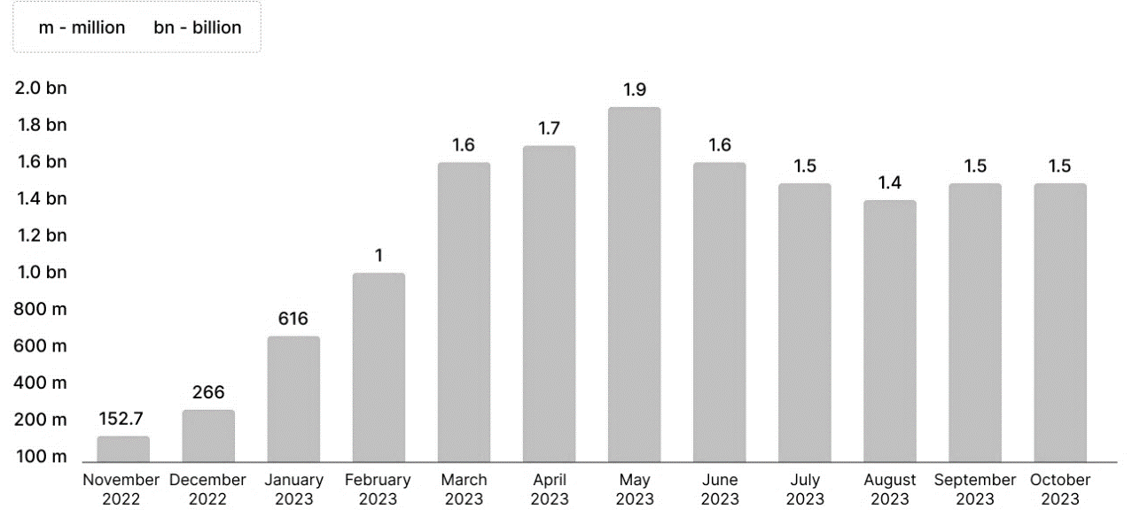
Background
Figure 1‑1: Monthly ChatGPT Website Visits (Source: SimilarWeb)

Slide 3
Objectives
Align with HMC research agenda Guzman and Lewis (2019)
Investigate preferences for chatbots style/attributes
Identify key traits in people that can act as predictors for chatbot preferences
“Design for improving chatbot user experience” Følstad et al. (2021)

Slide 4
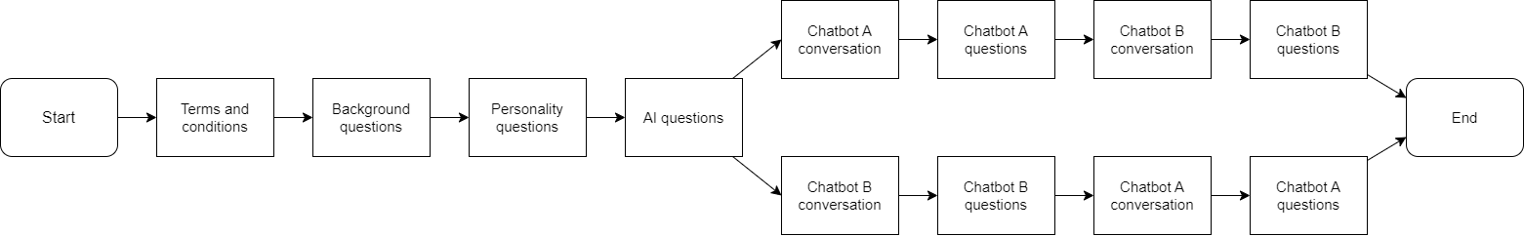
Methodology

Slide 5
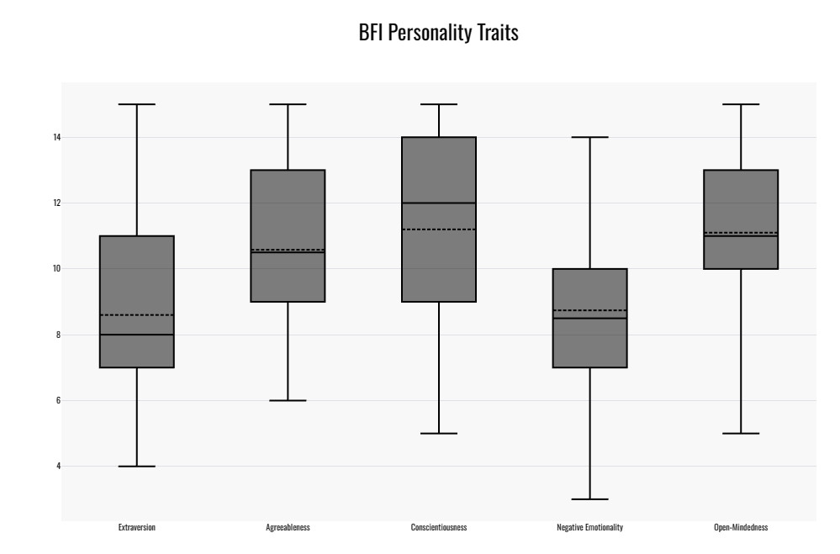
Results - Participants
50 participants: 29 men, 21 women

Slide 6
Results
No significance
Significance in the same direction
Significance in one direction
Significance in opposing directions

Slide 7
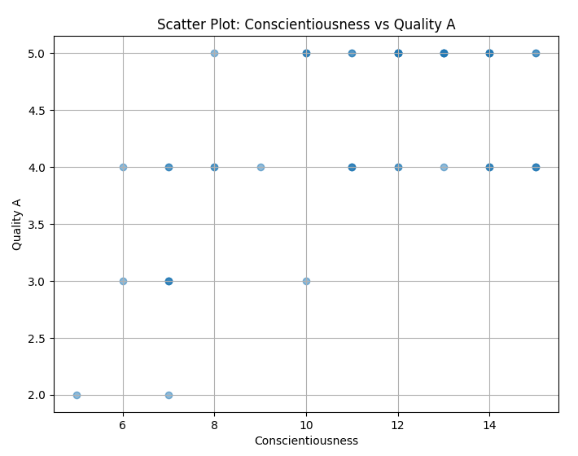
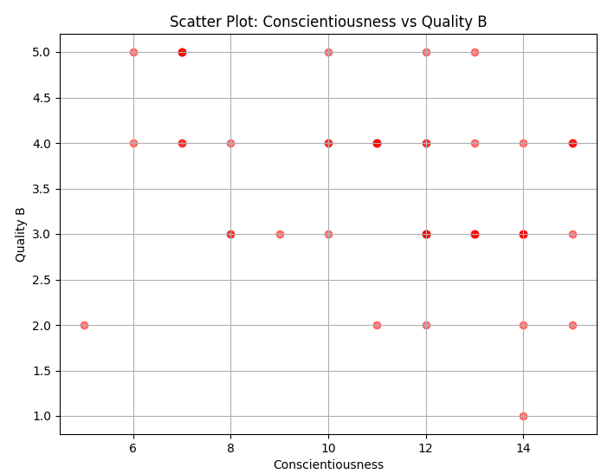
Conscientiousness and Quality (useful)

